Slide 1


Introduction to the on-campus part
Tariq Halasa
Carsten Kirkeby
Victoria Brookes
Michael Ward

Slide 2
Outline
Introduction of the teachers.
Aims and expectations
Focus
Structure
Examination project.
Evaluation
Round the table

Slide 3
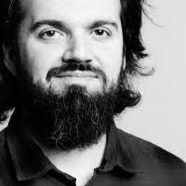
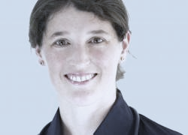
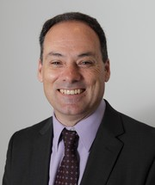
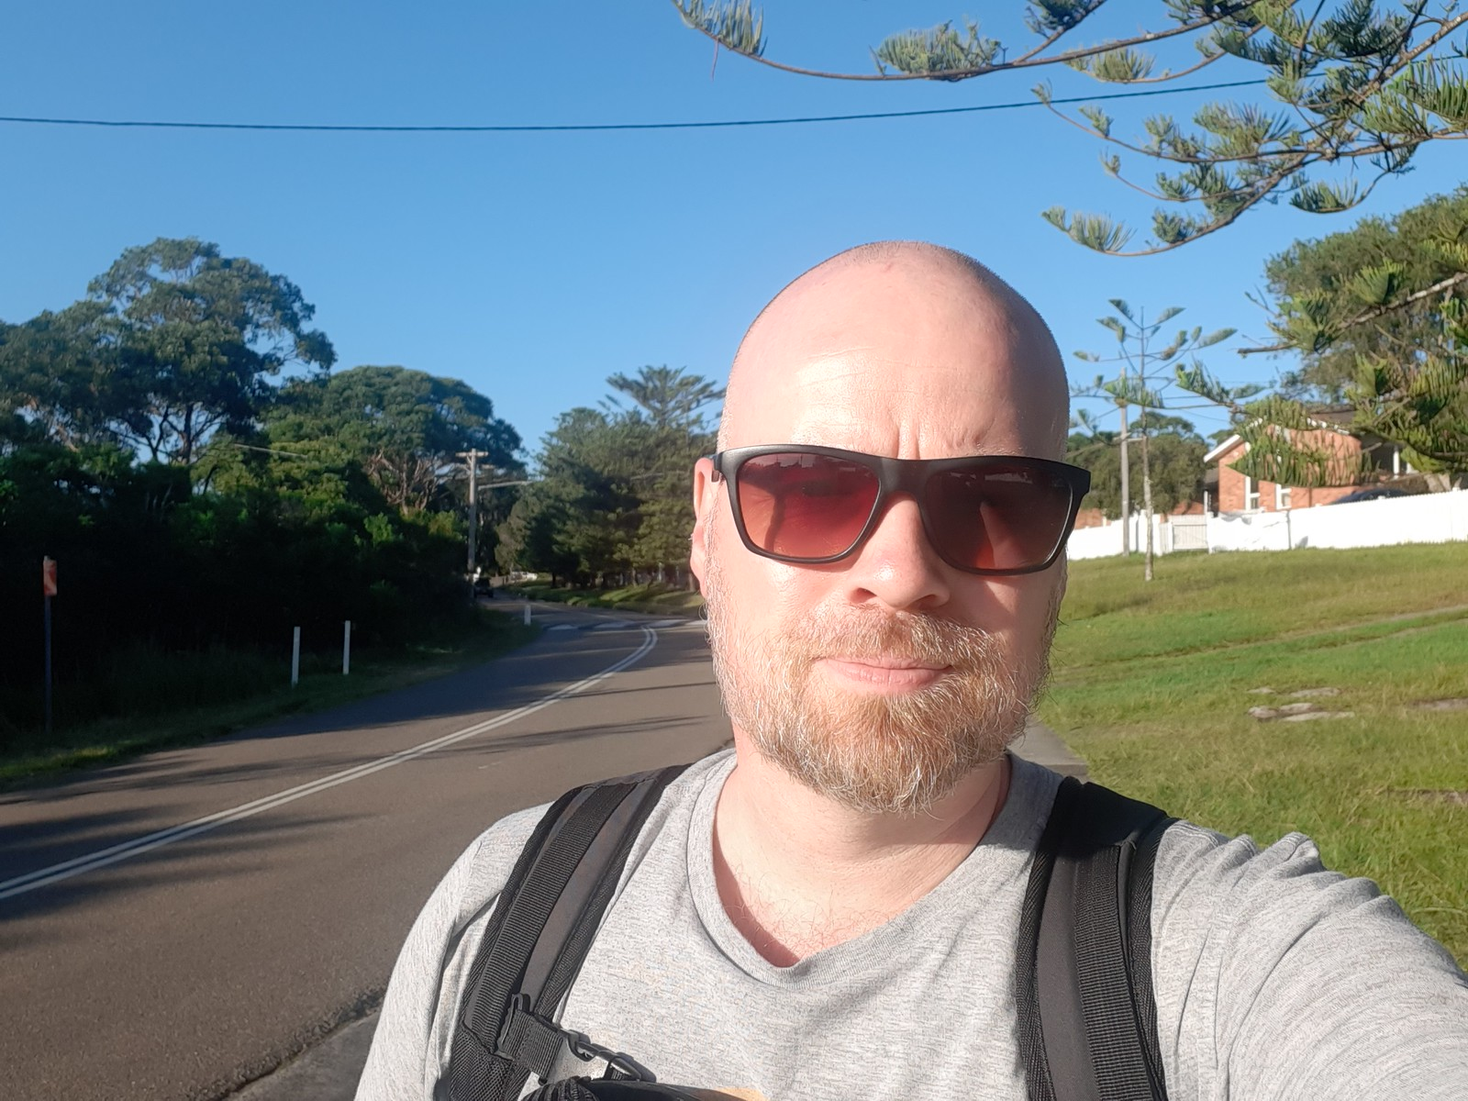
Who are we?
Victoria Brookes: Vet
Matt Denwood: Vet
Carsten Kirkeby: Biologist
Michael Ward: Vet

Slide 4
Aims for the course
Understand infectious disease principles relevant to disease modelling
Construct a dynamic model framework, implemented in R
Determine model characteristics and requirements for validation
Use the model to investigate a research question

Slide 5
Course focus
We will focus on mechanistic models – but the concept can be utilized in other models as well

Slide 6
Course focus
Day | Time | Activity/Contents | Details
1 | 8:30-10:00 | Introduction to disease models (+ infection risk and transmission rate / beta) | Powerpoint presentation
 | 10:00-10:30 | Bio break
 | 10:30-12:00 | Introduction to a simple model framework | Powerpoint presentation + Hands-on exercises
 | 12:00-13:00 | Lunch break
 | 13:00-14:30 | A simple model with disease dynamics 1 | Hands-on exercises
 | 14:30-15:00 | Bio break
 | 15:00-16:30 | A simple model with disease dynamics 2 | Hands-on exercises
 | 16:30-18:00 | A simple model with disease dynamics 3 | Hands-on exercises
Day | Time | Activity/Contents | Details
2 | 8:30-10:00 | A more complex model with disease and population dynamics 1 | Powerpoint + Hands-on exercises
 | 10:00-10:30 | Bio break
 | 10:30-12:00 | Model assumptions, validation, convergence and burn-in | Powerpoint presentation
 | 12:00-13:00 | Lunch break
 | 13:00-14:30 | Model evaluation | Hands-on exercises
 | 14:30-15:00 | Bio break
 | 15:00-16:00 | A more complex model with disease and population dynamics 2 | Hands-on exercises

Slide 7
Quick round the table
Who you are you?
What do you do?
What coding experience do you have?
Why do you join this course? (motivation)
What are your expectations from the course?

Slide 8
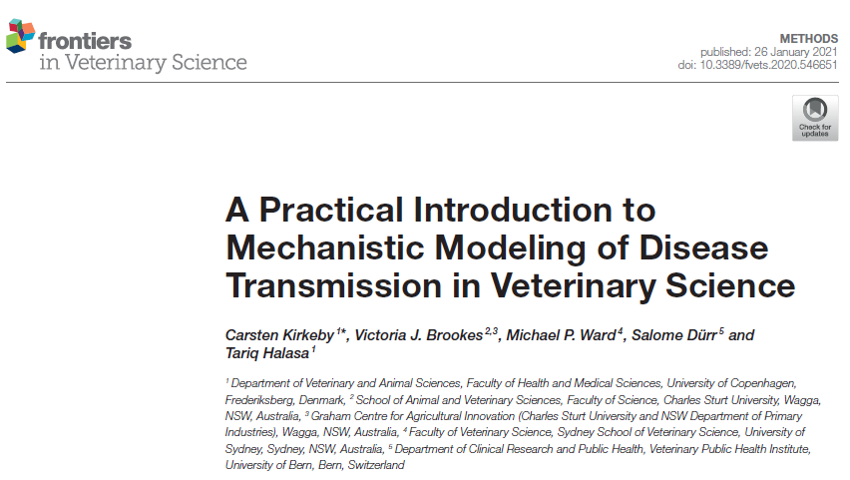
Let´s begin!

